Slide 1
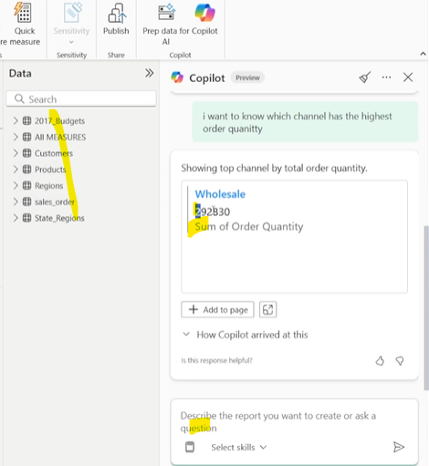
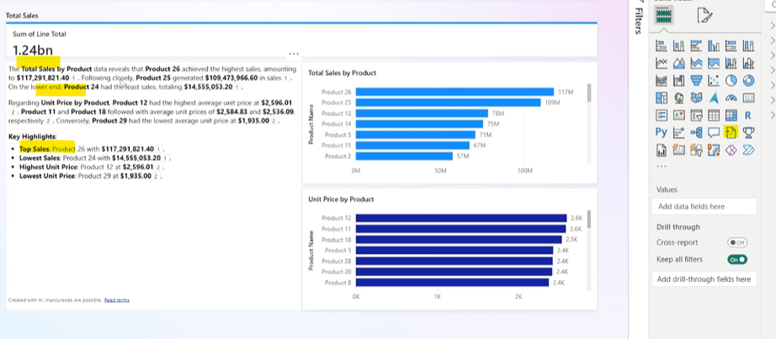
Gen AI for data
Prompt engenieering for data using Chatgpt GPT4 https://www.udemy.com/course/generative-ai-for-data-analysts-professionals/learn/lecture/50540209#questions
SQL query coding and debagging support using perplexity
Power BI reporting support with perplexity
Dax leaning with Preplexity
Copilot enabling for PBI and Fabric https://www.udemy.com/course/ai-powered-data-analytics-mastery-ai-tools-vibe-coding/learn/lecture/51323369#overview
PBI Copilot use case :
Measures and corresponding descriptions
Explore data using copilot
Explain DAX query using copilot
Generate simple report based on data set with copilot
Narative visuals
Chat with your dataset using copilot
Analysis , modifying files (csv , Json) and automate the full process using Clause , powerShell and VS csv , json example files https://www.udemy.com/course/generative-ai-for-data-engineering/learn/lecture/41676070#overview
Data quality check with Caude support and VS https://www.udemy.com/course/generative-ai-for-data-engineering/learn/lecture/41676120#overview

Slide 2
Gen AI with SQL prompts
"Translate the question: 'What are the top 5 products by revenue in the last quarter?' into an optimized SQL query using the 'sales_data' table.“
"Write a SQL query to find the average monthly spend of customers who made more than 3 purchases in the last 60 days.”
Generate a SQL statement to return churn rate by month using the 'customer_status' and 'churn_date' columns.
"Convert: 'Show me daily active users for each platform over the past 30 days' into a performant SQL query using the 'login_events' table.“
"Given tables 'orders' and 'products', create a query that lists the top 3 categories by total order count and revenue.“
"Write a SQL query to detect customers who haven’t transacted in over 180 days but had transactions before.“
Create a SQL query to calculate customer retention rate cohort-wise using signup and first_purchase_date columns.
"Transform this question into SQL: 'Which marketing channel resulted in the highest conversion rate last month?’”
"Write a join query combining 'orders', 'customers', and 'payments' to show total revenue by customer region.“
"Build a SQL query to show the percentage of users who upgraded from free to premium within 30 days of signup.“
"Write a nested SQL query to find products whose average review score is below 3.5 and return their monthly sales.“
"Convert this business question into SQL: 'What was the average ticket size for repeat customers vs new customers last year?'"
"Generate a SQL query to calculate lifetime value (LTV) for customers grouped by acquisition source.“
Write a CTE-based query that shows the churn rate trend over the last 12 months segmented by subscription plan.“
"Translate: 'Which days of the week have the highest return rate?' into an efficient SQL query using 'order_returns’.”
Create a query to list the top 10 customers by revenue growth comparing this year to last year.“
Generate a SQL query that identifies products with increasing weekly sales for three consecutive weeks.“
"Given a table with event timestamps, write a SQL query to calculate user session duration and average time per session.“
"Translate this into SQL: 'Which regions experienced more than a 10% drop in monthly revenue compared to the previous month?’”
"Generate a parameterized SQL query that retrieves customer purchase history based on dynamic date range input."

